Slide 1
Week 4 AWS S3 and DynamoDB
Dr Zhi Zhang

Slide 2
Overview
Amazon S3 (Simple Storage Service)
Amazon DynamoDB
Mid-semester Test

Slide 3

Cloud storage
Cloud storage, provided by a third-party cloud provider allows individuals and organizations to store and access data over the internet through remote servers.
Examples: ?

Slide 4
Cloud storage
Cloud storage, provided by a third-party cloud provider allows individuals and organizations to store and access data over the internet through remote servers.
Examples: Dropbox, Google drive, iCloud, Amazon S3

Slide 5
Amazon S3 (Simple Storage Service)
It is a popular and widely used cloud storage service provided by AWS
It allows users to store and retrieve any amount of data at any time over the internet
Bucket
Object

Slide 6
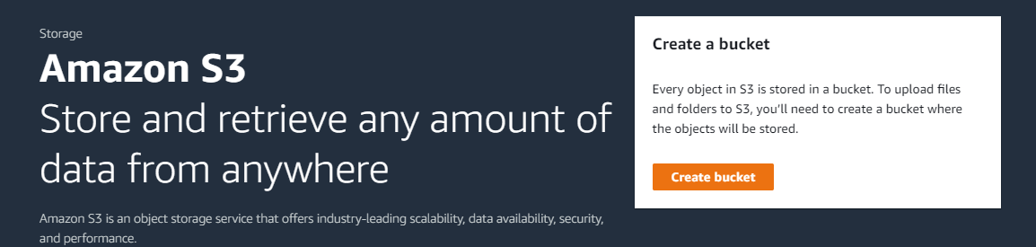
Create bucket

Slide 7
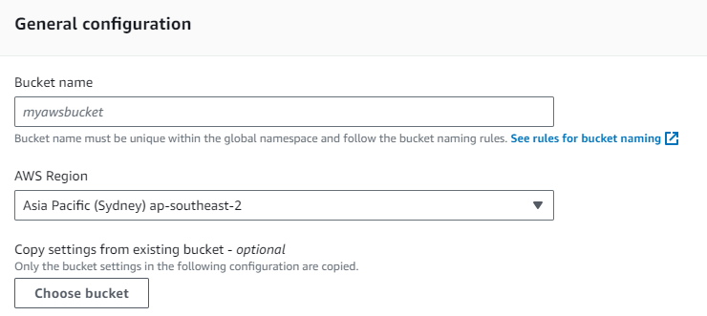
Create Bucket
Note:
Bucket name must be unique within the global namespace.
It must follow the bucket naming rules.

Slide 8
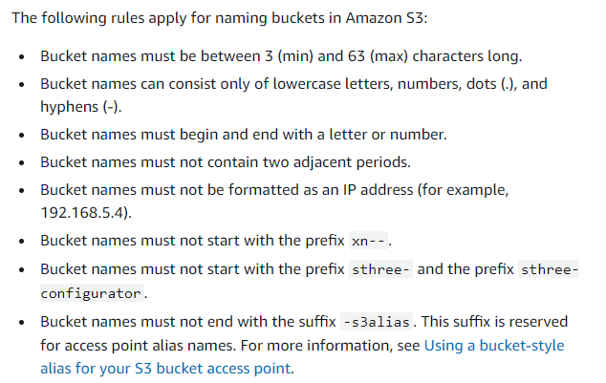
Rules for bucket naming

Slide 9
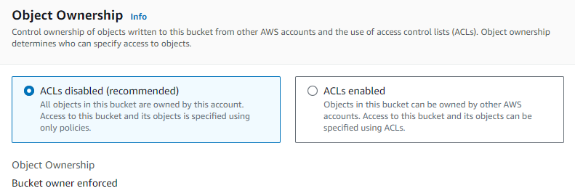
Object ownership
What is an object?

Slide 10
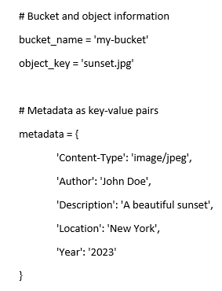
Object
It is an individual unit of data stored in a bucket
Can be a file of any type:
documents, images, videos, etc
It contains both data and metadata:
Data refers to file contents. Metadata include file attributes.
e.g., a file called sunset.jpg is uploaded into a bucket.

Slide 11
Object
It is an individual unit of data stored in a bucket
Can be a file of any type:
documents, images, videos, etc
It contains both data and metadata:
Data refers to file contents. Metadata include file attributes.
e.g., a file called sunset.jpg is uploaded into a bucket.
How to identify an object? object key + version ID (if enabled)
Object key is a string specifying the object’s location and name, e.g., 0123456-my-first-bucket/subdir/sunset.jpg
Version ID: denotes a specific version of an object, e.g., Version ID: v1AbCdEfGhIjKlMnOpQrStUvWxYz1234567890
A combination of an object key and version ID uniquely identifies a specific version of an object in a bucket.

Slide 12
Object ownership
Bucket ACLs are old access-control mechanism for buckets.

Slide 13
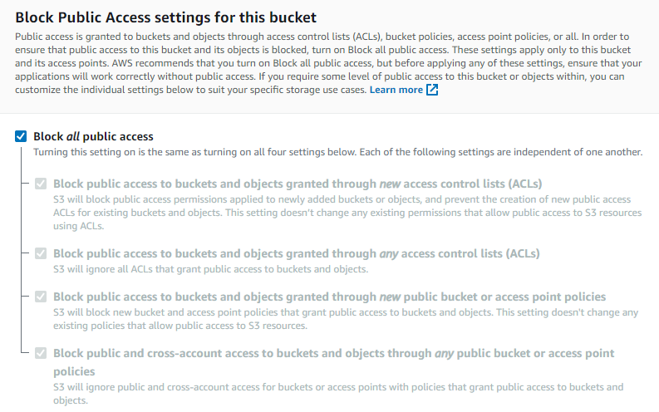
Block Public Access settings for this bucket

Slide 14
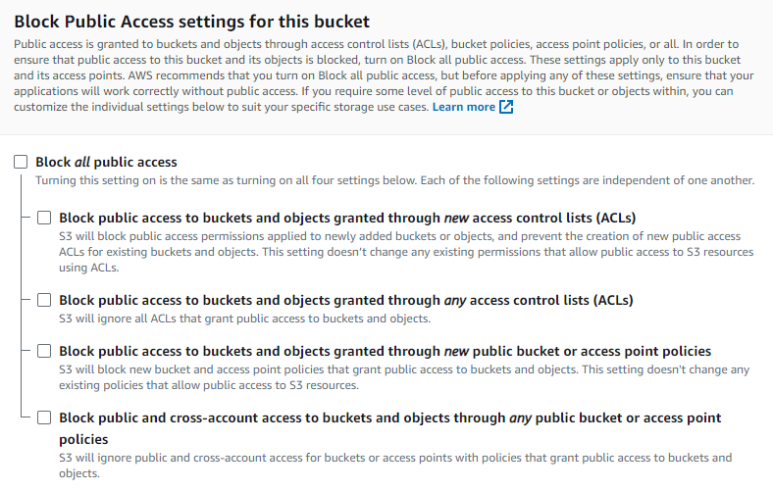
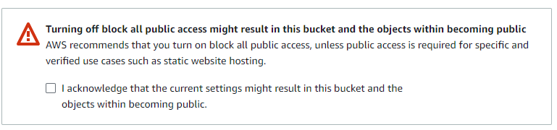
Block Public Access settings for this bucket

Slide 15
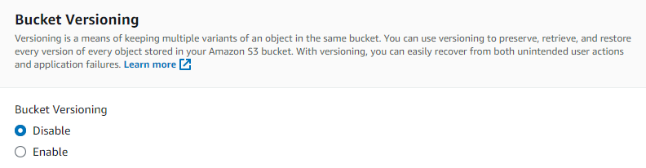
Bucket versioning

Slide 16
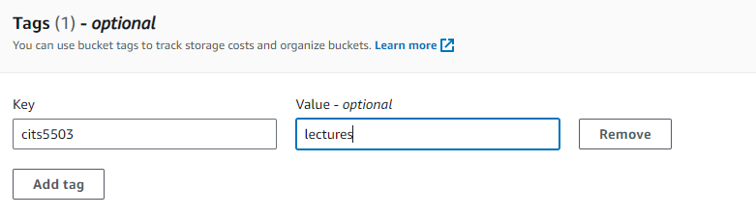
Tags
Tags are key-value pairs that provide customized label to help identify and manage our buckets, e.g.,
For a bucket of cits5503/lectures, where ‘cits5503’ is a tag key and ‘lectures’ is a tag value.
For a bucket of cits5503/labs, where ‘cits5503’ is a tag key and ‘labs’ is a tag value.

Slide 17
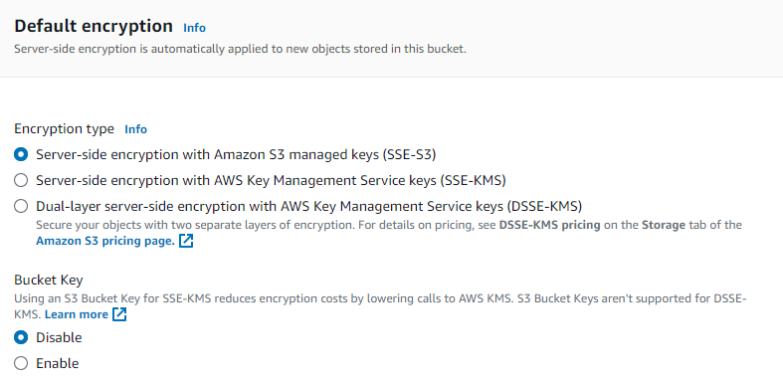
Default encryption

Slide 18

Default encryption
Server-side encryption with S3 managed keys (SSE-S3): S3 manages the encryption keys (AES-256 encryption) used to encrypt and decrypt objects.
Server-side encryption with AWS Key Management Service keys (SSE-KMS): It uses KMS to manage the encryption keys for each object stored in the bucket.

Slide 19
Default encryption
Server-side encryption with S3 managed keys (SSE-S3): S3 manages the encryption keys (AES-256 encryption) used to encrypt and decrypt objects.
Server-side encryption with AWS Key Management Service keys (SSE-KMS): It uses KMS to manage the encryption keys for each object stored in the bucket.
Dual-layer server-side encryption with AWS KMS (DSSE-KMS): It is a combination of SSE-S3 and SSE-KMS.

Slide 20
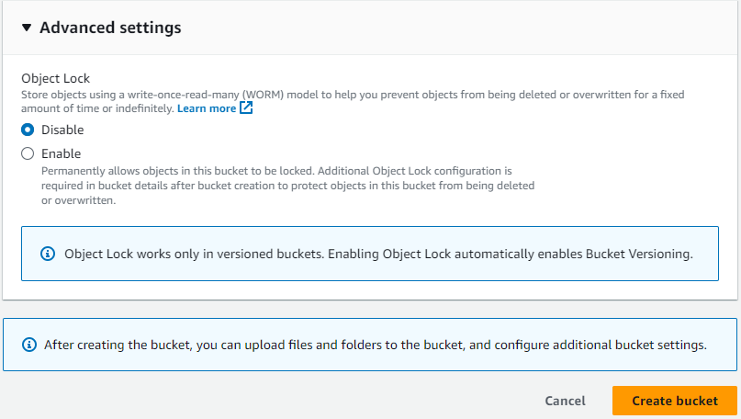
Object lock

Slide 21
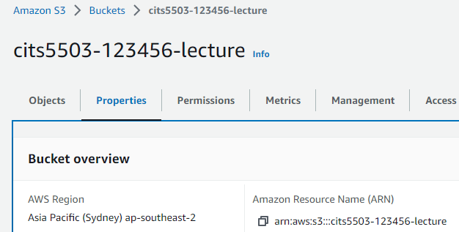
Configure a bucket
ARN: a unique ID for any AWS resources, such as S3 buckets, EC2 instances and IAM users.
ARN is needed when configuring a bucket policy

Slide 22
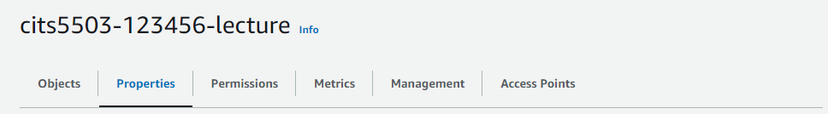
Configure a bucket
Properties
Bucket versioning
Tags
Default encryption
Object Lock
Server access logging
Provides records for the requests that are made to a bucket.

Slide 23
Configure a bucket
Permissions
Bucket policy
CORS (Cross-origin resource sharing) policy

Slide 24
Bucket policy
Secure access to objects in one or more buckets
For unauthenticated users, access is denied
For authenticated users, access is dependent on their permissions

Slide 25
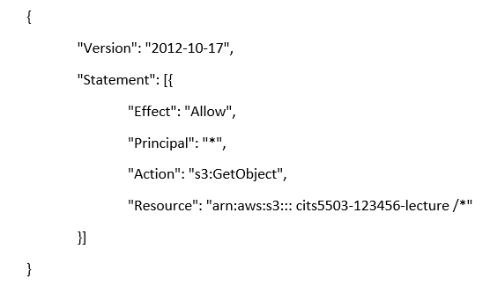
Bucket policy
Secure access to objects in one or more buckets
For unauthenticated users, access is denied
For authenticated users, access is dependent on their permissions
Version: indicates the language version of the policy language.
Statement: represents a permission rule.
Effect: what the effect will be when a user requests the specific action—this can be either ’Allow’ or ’Deny’.
Principal: refers to a set of users/applications who have access to the actions and resources in the statement.
Action: defines a set of resource operations a user/application is allowed (or denied) to perform.
Resource: specifies AWS resources for which a user is allowed or denied to take actions. ARN identifies the bucket.

Slide 26
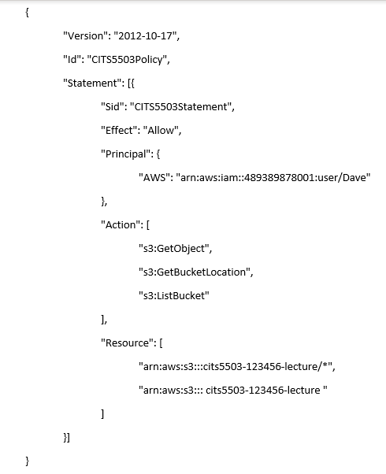
Bucket policy
Id: An optional identifier for the policy, denoting a unique name for the policy.
Sid: An optional identifier for the statement, denoting a unique name for the statement.
s3:GetObject: Allows users to read objects in the bucket.
s3:GetBucketLocation: Allow users to retrieve the bucket's region.
s3:ListBucket: Allows users to list the objects in the bucket.
What is the difference between the two ARNs in the Resource field?

Slide 27
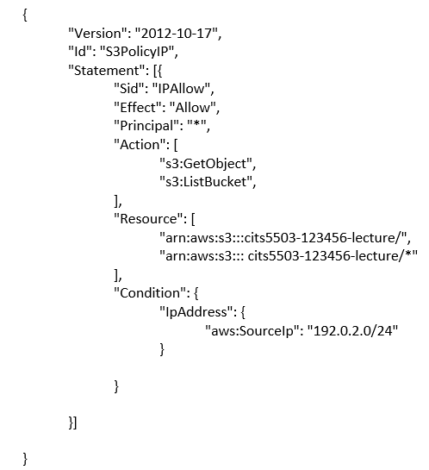
Bucket policy: practice
What does this code snippet do?

Slide 28
Bucket policy: practice
This policy allows two operations to the bucket named "cits5503-123456-lecture") and its contents from IP addresses within the "192.0.2.0/24" range. This range covers all IP addresses from 192.0.2.0 to 192.0.2.255, inclusive.
What does 192.0.2.0/16 mean?

Slide 29
Common S3 actions
s3:GetObject: Allow users to read objects from the bucket.
s3:PutObject: Allow users to upload new objects to the bucket.
s3:DeleteObject: Allow users to delete objects from the bucket.
s3:ListBucket: Allow users to list the objects in the bucket.
s3:GetBucketLocation: Allow users to retrieve the bucket's region.
A complete list of actions (https://docs.aws.amazon.com/AmazonS3/latest/API/API_Operations.html)

Slide 30
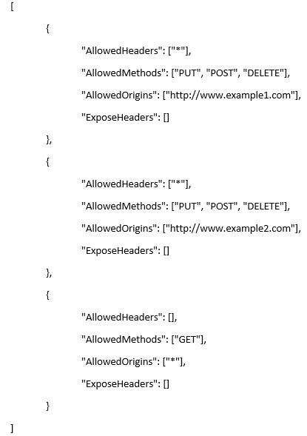
CORS (Cross-origin Resource Sharing )
CORS allows specific origins to access a bucket and specifies the allowed HTTP methods and headers for each origin.
An example:
Rule 1:
AllowedHeaders: All headers are allowed.
AllowedMethods: PUT, POST, and DELETE HTTP methods are allowed.
AllowedOrigins: HTTP requests originating from "http://www.example1.com" are allowed to access the bucket.
ExposeHeaders: No additional headers are exposed.
Rule 2: The same as Rule 1 except the origin.
Rule 3:
AllowedHeaders: No specific headers are allowed.
AllowedMethods: Only the GET HTTP method is allowed.
AllowedOrigins: All origins are allowed.
ExposeHeaders: No additional headers are exposed.

Slide 31
Demo (python)
Create a bucket, called cits5503-lecture-bucket
Enable bucket versioning
PUT an object (called uwa_campus.jpg) into the bucket
GET the uploaded object from the bucket
Update uwa_campus.jpg in the cits5503-lecture-bucket
When we PUT an object, it gets a new version
GET the latest version of uwa_campus.jpg
When we get an object:
1) an unversioned request likely receives the last version, but this is not guaranteed;
2) a request for object key + version ID uniquely maps to a single object of a specified version.

Slide 32
Practice Questions
[5 marks] Q1: When a bucket is created, AWS allows the specification of a number of features that can be managed. What are the key properties and features?

Slide 33
Practice Questions
[5 marks] Q1: When a Bucket is created, AWS allows the specification of a number of features that can be managed. What are the key properties and features?
[1 mark] Bucket Name: A unique name that identifies a bucket. Bucket names must be globally unique across all existing bucket names in S3.
[1 mark] Region: a bucket is associated with an AWS region, which determines the physical location where a bucket is stored.
[1 mark] Bucket versioning: keeps multiple versions of an object in the same bucket.
[1 mark] Default Encryption: All objects uploaded to the bucket will be automatically encrypted using one server-side encryption.
[1 mark] Object Lock: it prevent objects in a bucket from being deleted or overwritten for a fixed amount of time or indefinitely.

Slide 34
Practice Questions
[5 marks] Q2: Describe how S3 handles consistency of objects and how this approach affects the state of objects when they are read using a GET.

Slide 35
Practice Questions
[5 marks] Q2: Describe how S3 handles consistency of objects and how this approach affects the state of objects when they are read using a GET.
[4 marks] S3 delivers strong read-after-write and list (i.e., GET, PUT and LIST operations) consistency automatically. Specifically, what a user write is what they will read, and the results of a LIST will be an accurate reflection of what’s in the bucket.
[1 mark] When GET is used to read an object, the read request immediately receives the latest version of the object.

Slide 36
Amazon DynamoDB
A fast and flexible non-relational database service
List a real-world relational database management system: ?

Slide 37
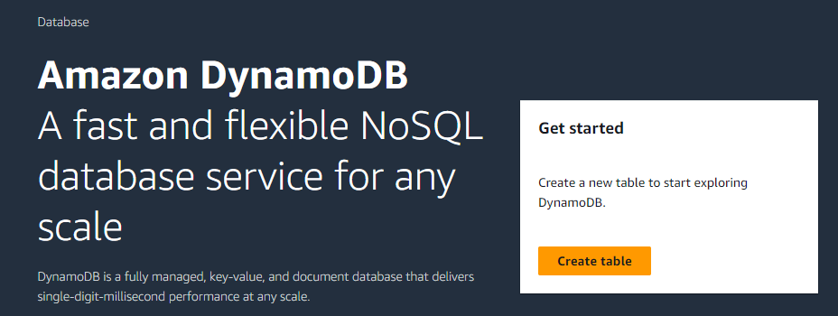
Amazon DynamoDB
A fast and flexible non-relational database service
List a relational database management system: MySQL, PostgreSQL, etc.

Slide 38
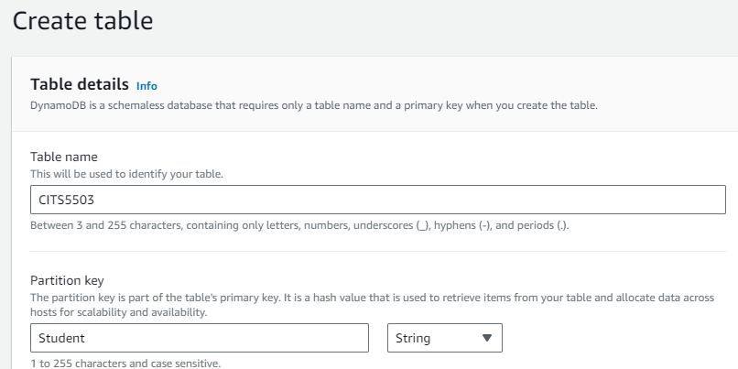
Amazon DynamoDB

Slide 39
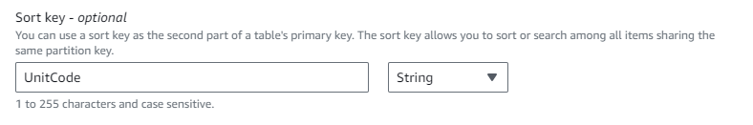
Amazon DynamoDB
A composite primary key composed of partition key and sort key (table columns)
CITS5503
Student | UnitCode
partition key/hash key
sort key/range key

Slide 40
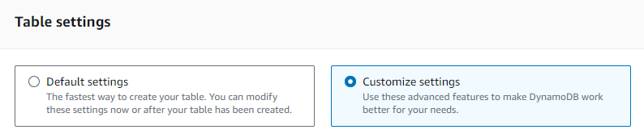
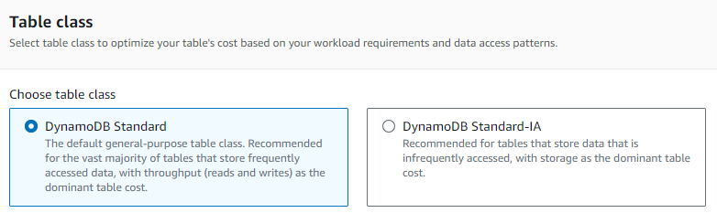
Core Components
Amazon DynamoDB

Slide 41
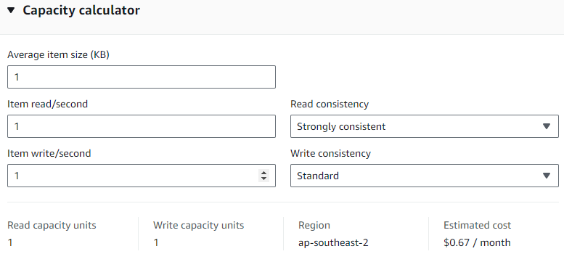
Core Components
Amazon DynamoDB
Throughput capacity
1 read/write capacity unit (RCU/WCU) = read/write 1 item of 1 KB in 1 second

Slide 42
Read/Write consistency
Read from DynamoDB can be:
Eventually Consistent
The response of a read may not reflect the result of a recent write operation
Strongly Consistent
The response of a read returns the most up-to-date data reflecting all updates from all previous write operations
Transactional
Group multiple read actions together and submit them in a single all-or-nothing operation
Write from DynamoDB can be:
Standard
Transactional
Group multiple read actions together and submit them in a single all-or-nothing operation

Slide 43
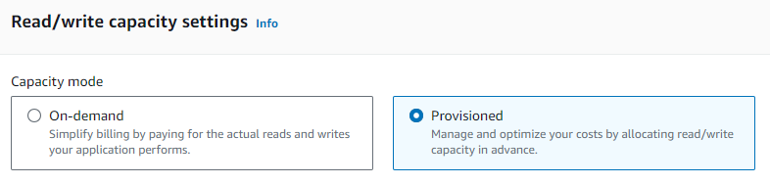
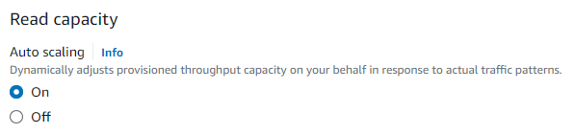
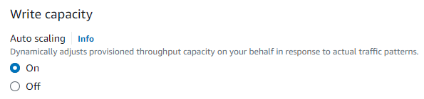
Core Components
Amazon DynamoDB

Slide 44
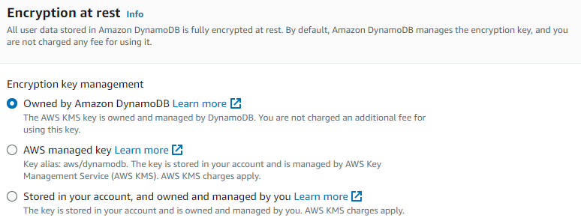
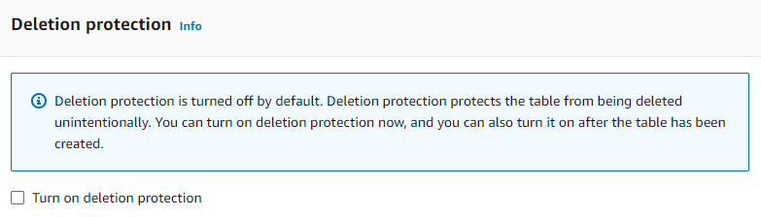
Core Components
Amazon DynamoDB

Slide 45
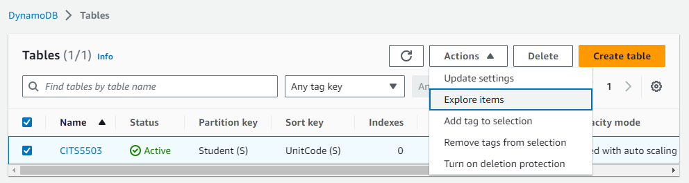
Core Components
Amazon DynamoDB

Slide 46
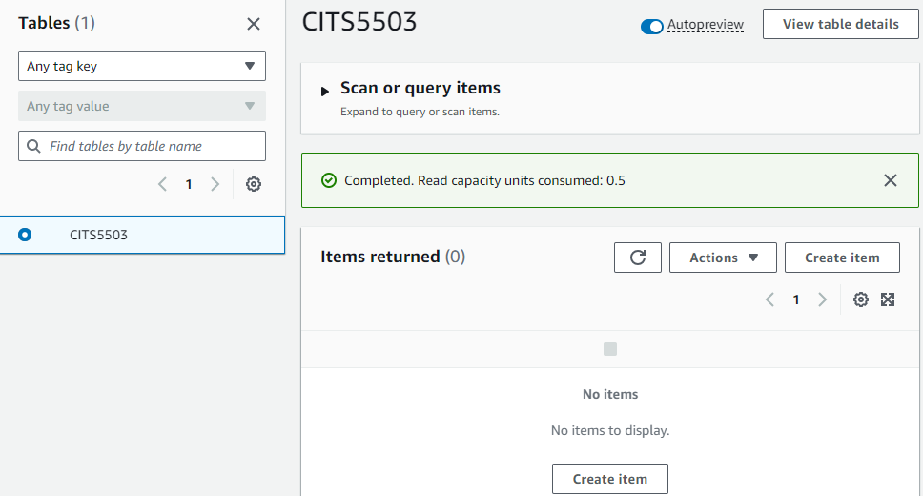
Core Components
Amazon DynamoDB

Slide 47
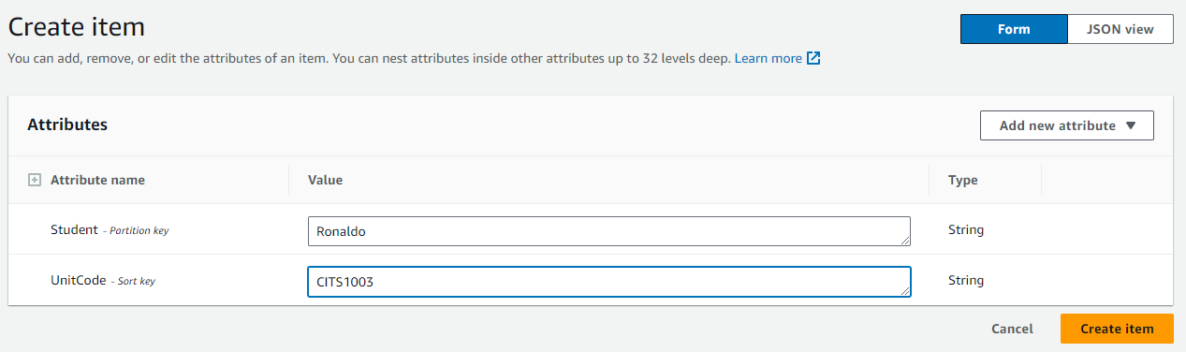
Core Components
Amazon DynamoDB

Slide 48
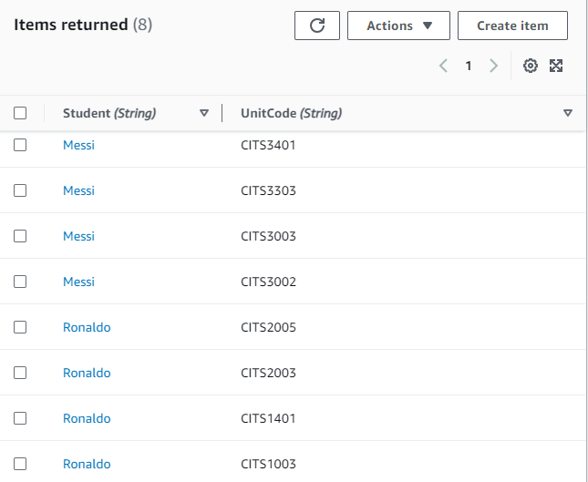
Core Components
Amazon DynamoDB
The table looks similar to a spreadsheet

Slide 49
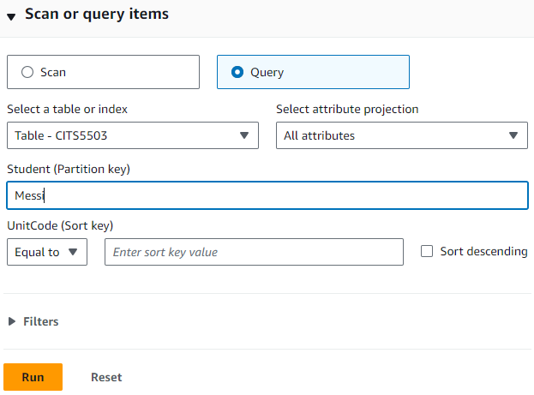
Core Components
Amazon DynamoDB

Slide 50
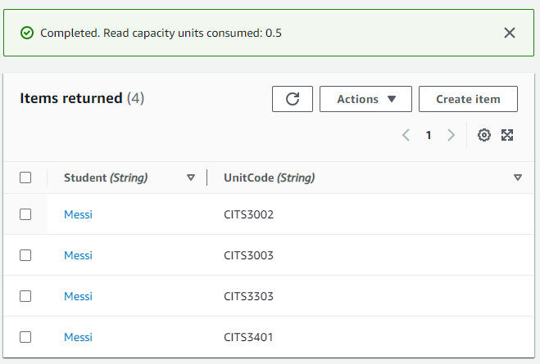
Core Components
Amazon DynamoDB

Slide 51
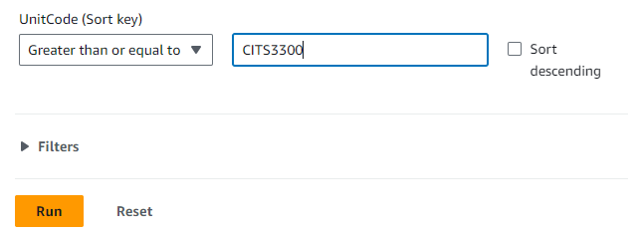
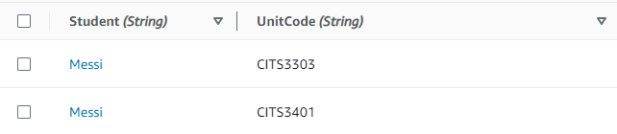
Core Components
Amazon DynamoDB

Slide 52
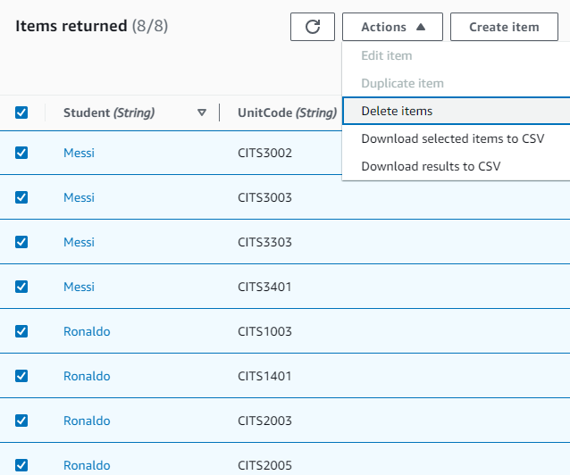
Core Components
Amazon DynamoDB

Slide 53
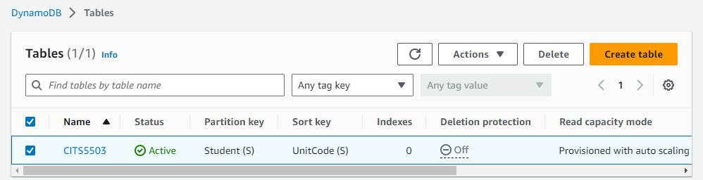
Core Components
Amazon DynamoDB

Slide 54
DynamoDB API
Control Plane (manage a table)
CreateTable, DescribeTable, ListTables, UpdateTable, DeleteTable
Data Plane (manage data in a table)
Create data: PutItem/BatchWriteItem
Read data: GetItem/BatchGetItem/Query/Scan
Update data: UpdateItem
Delete data: DeleteItem/BatchWriteItem
A summary of API operations
https://docs.aws.amazon.com/amazondynamodb/latest/developerguide/HowItWorks.API.html#HowItWorks.API.ControlPlane

Slide 55
Practice Questions
Q3: You are asked to store data about music albums in a local DynamoDB table. For each album, you need to record the title of the album and the artist name. Describe the AWSCLI commands you would use to create a table to store such information and write entries to that table in DynamoDB.

Slide 56
Set up a local DynamoDB
From a terminal:
mkdir dynamodb; cd dynamodb
install jre if not done (sudo apt-get install default-jre)
wget https://s3-ap-northeast-1.amazonaws.com/dynamodb-local-tokyo/dynamodb_local_latest.tar.gz
java -Djava.library.path=./DynamoDBLocal_lib -jar DynamoDBLocal.jar –sharedDb

Slide 57
Create Table
1
2
3
4
5
6
7
8
aws dynamodb create-table --table-name MusicAlbum
--attribute-definitions \
AttributeName=Artist,AttributeType=S \
AttributeName=Song,AttributeType=S \
--key-schema AttributeName=Artist,KeyType=HASH \
AttributeName=Song,KeyType=RANGE \
--provisioned-throughput ReadCapacityUnits=1,WriteCapacityUnits=1 \
--endpoint-url=http://localhost:8000

Slide 58
Create Table
1
2
3
4
5
6
7
8
aws dynamodb create-table --table-name MusicAlbum
--attribute-definitions \
AttributeName=Artist,AttributeType=S \
AttributeName=Song,AttributeType=S \
--key-schema AttributeName=Artist,KeyType=HASH \
AttributeName=Song,KeyType=RANGE \
--provisioned-throughput ReadCapacityUnits=1,WriteCapacityUnits=1 \
--endpoint-url=http://localhost:8000
Creates a table named "MusicAlbum" with two attributes ("Artist" and "Song"),
Sets up "Artist" as the partition key and "Song" as the sort key,
Assigns provisioned throughput capacity of 1 read capacity unit and 1 write capacity unit,
Connects to a DynamoDB instance running locally on http://localhost:8000.

Slide 59
Create Entries
1
2
3
4
5
6
7
8
9
10
aws dynamodb put-item \
--table-name MusicAlbum \
--item \ '{"Artist": {"S": “Tom"}, "Song": {"S": "Call Me Today"}}’\
--return-consumed-capacity TOTAL --endpoint-url=http://localhost:8000
aws dynamodb put-item \
--table-name MusicAlbum \
--item '{"Artist": {"S": “Jerry"}, "Song": {"S": "Happy Day"}}’ \
--return-consumed-capacity TOTAL --endpoint-url=http://localhost:8000

Slide 60
Create Entries
1
2
3
4
5
6
7
8
9
10
aws dynamodb put-item \
--table-name MusicAlbum \
--item \ '{"Artist": {"S": “Tom"}, "Song": {"S": "Call Me Today"}}’\
--return-consumed-capacity TOTAL --endpoint-url=http://localhost:8000
aws dynamodb put-item \
--table-name MusicAlbum \
--item '{"Artist": {"S": “Jerry"}, "Song": {"S": "Happy Day"}}’ \
--return-consumed-capacity TOTAL --endpoint-url=http://localhost:8000
Insert two items with values about of attributes,
Request information about the consumed capacity for the operations,
Specify a local DynamoDB for the connection.
What if we want to add one more attribute to this table, e.g., AlbumTitle?

Slide 61
Create Entries
1
2
3
4
5
6
7
8
9
10
11
12
aws dynamodb put-item \
--table-name MusicAlbum \
--item \ '{"Artist": {"S": “Tom"}, "Song": {"S": "Call Me Today"},
"AlbumTitle": {"S": "Somewhat Famous"}}’ \
--return-consumed-capacity TOTAL --endpoint-url=http://localhost:8000
aws dynamodb put-item \
--table-name MusicAlbum \
--item '{"Artist": {"S": “Jerry"}, "Song": {"S": "Happy Day"}, \
"AlbumTitle": {"S": "Songs About Life"} }’ \
--return-consumed-capacity TOTAL --endpoint-url=http://localhost:8000

Slide 62
Query
1
2
3
4
5
aws dynamodb query \
--table-name MusicAlbum \
--key-condition-expression "Artist = :artist" \
--expression-attribute-values '{":artist":{"S":"Tom"}}’ \
--endpoint-url=http://localhost:8000

Slide 63
Query
1
2
3
4
5
aws dynamodb query \
--table-name MusicAlbum \
--key-condition-expression "Artist = :artist" \
--expression-attribute-values '{":artist":{"S":"Tom"}}’ \
--endpoint-url=http://localhost:8000
Queries the "MusicAlbum" table for items where the "Artist" is "Tom".

Slide 64
Scan
1
2
3
aws dynamodb scan \
--table-name MusicAlbum \
--endpoint-url=http://localhost:8000

Slide 65
Data Types
Attributes can be:
Scalar Types: represent exactly one value
Number, String, Binary, Boolean, null
Set Types: an array of the same scalar type
["Black", "Green" ,"Red"]
[42.2, -19, 7.5, 3.14]
Document Types
A detailed description of data types:
https://docs.aws.amazon.com/amazondynamodb/latest/developerguide/HowItWorks.NamingRulesDataTypes.html#HowItWorks.DataTypes

Slide 66
Document Types
List: a collection of values, enclosed in square brackets: [ ... ]
FavoriteThings: ["Cookies", "Coffee", 3.14159]
Map: a hierarchical structure of attributes within a single attribute, enclosed in curly brackets: {...}
{
Day: "Monday",
UnreadEmails: 42,
ItemsOnMyDesk: [
"Coffee Cup",
"Telephone",
{
Pens: { Quantity : 3},
Pencils: { Quantity : 2}
}
]
}

Slide 67
Mid-sem test format
The exam has a time limit of 60 mins
The exam is at 3:00pm-4:00pm on 29/08/23.
The exam has two main venues: ARTS[G59] and ARTS[159]
Students with UAAP sit in CSSE: [ 228] Tutorial Room
The exam is marked out of 60 points and worth 30% of the overall unit mark.
The exam is close-book: NO notes are allowed.
The exam is F2F for all students.
Your name and student ID must be written on the cover page of the question booklet.
Please do NOT use a pencil or a red pen.
Please use readable handwriting. What cannot be read cannot be marked.

Slide 68
Exam Topics
4 lecture slides and 3 labs are assessed.
Multi-choice questions (15 marks)
15 questions
Each question has only one correct answer and is worth of 1 mark
Multi-answer questions (15 marks)
5 questions
Each question has >=2 correct answers and worth of 3 marks. For each question, if you pick all correct answers, full marks; if you miss some correct answers, half of the marks; if you pick an incorrect answer, 0 mark. For example: If the correct answers are AB for a 4-choice question, then
Your answer | AB | A or B | Others
Your marks | 3 marks | 1.5 marks | 0 mark

Slide 69
Exam Topics
4 lecture slides and 3 labs are assessed.
Multi-choice questions (15 marks)
Multi-answer questions (15 marks)
Short answer questions including coding (30 marks)
Read given code snippets and explain their main ideas
For practice
Focus on the practice questions in the slides of this year.
Questions from mid-sem test of last year can be provided but they are quite different
They are selected from the assignments.md (https://github.com/zhangzhics/CITS5503_Sem2_2023/blob/master/assignments.md)

